Slide 1
Resume Finder
A tool for line managers
Noor Altaweel
Jason Henry
Darius Rafei

Slide 2
Site Overview
Purpose/Need
Solution
Technology Stack
Features
Demo

Slide 3
Purpose/Need
In many organizations recruitment teams drive the (tier 1) candidate screening process.
Challenges:
Recruitment personnel are not always “in sync” with line managers with regards to the specific resource needs (Required/Desired Skills, Importance/Weighting, etc.)
Recruiting staff often solely focus on “Firm” vs. “Contingent” positions (i.e. those where funding is in place vs. those that could become firm given the right candidate)

Slide 4
Solution – Resume Finder
Benefits
Increases hiring manager’ candidate visibility
Many resumes that are submitted are never reviewed due to mismatch against posted job requisitions.
Allows managers to leverage candidate pool for more than just “Firm” positions.
Current employee performance.
Short term need
Response to customer ideas: “if we just had a good…..”
Create open dialogue with candidates for future needs
Creates a candidate pool that can be leveraged for targeted recruitment events, etc.
Indirect collaboration with other line managers
Manager Reviews

Slide 5





Technology Stack
FRONT END
BACK END
HTML 5/ CSS
React.js
react-router-dom
react-bootstrap
amazon-cognito-identity-js and AWS- SDK , crypto.js
S3 storage
Mongo DB
Node.js
Express and axios
Build script to connect front end to back end
Github
Heroku / EL beanstalk

Slide 6
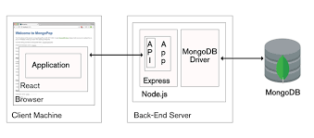
Architecture

Slide 7


Features
Beta Release
Manager Creation and Authentication via Cognito
Candidate Record Entry
Candidate resume stored in AWS S3
Candidate Reviews
Resume Text Search
Candidate Profile
whispering-sea

Slide 8

whispering-sea

